Slide 1

What is bioinformatics? Overview and Applications
12 September 2015
Dr Aquillah Kanzi

Slide 2

Overview
Define bioinformatics in practical terms
Understand how bioinformatics drives biological discovery
Explore key applications of bioinformatics in infectious disease

Slide 3
What is Bioinformatics
Computer Science
Biology
Mathematics
Bioinformatics is a multidisciplinary field that uses computational science, mathematics and statistics to analyse large biological data
Bioinformatics

Slide 4
What is Bioinformatics
Computer Science
Biology
Mathematics
Key components:
Data management
Storage and organization of biological data
Quality management and preprocessing
Algorithm development
Development of computational tools for data analysis and modeling biological processes
Biological interpretation
Large scale analysis and visualization
Integration with experimental validation
Bioinformatics

Slide 5
Bioinformatics vs Computational Biology
Aspect | Bioinformatics | Computational Biology
Definition | A multidisciplinary field combining biology, computer science, and big data analytics to collect, store, and analyse large biological datasets. | A field that applies computational, mathematical, and statistical methods to model, simulate, and understand biological systems and processes.
Focus | Developing tools, databases, and algorithms to handle and interpret large-scale biological data (e.g., genomics, transcriptomics). | Creating and applying mathematical models, statistical inference, and simulations to understand biological mechanisms and processes.
Goal | Efficiently manage, analyse, and visualize big data to derive biological insights; often uses machine learning, AI, and high-performance computing. | Use computational models to generate hypotheses, test biological theories, and understand the “why” behind biological patterns and phenomena.
Application | Genome sequencing, transcriptomics, proteomics, big data integration, machine learning for biology, personalized medicine, and systems biology. | Population genetics, phylogenetics, protein structure modelling, pathway analysis, epidemiological modelling, and theoretical biology.
Bioinformatics makes it possible to understand genetic data and underlying biological processes which would be otherwise impossible to achieve manually

Slide 6
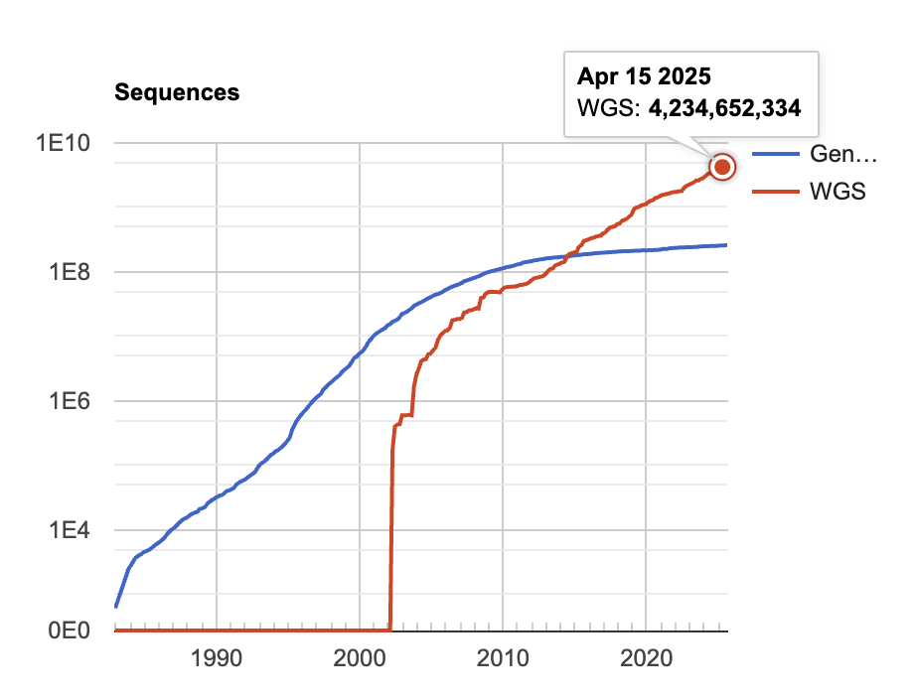
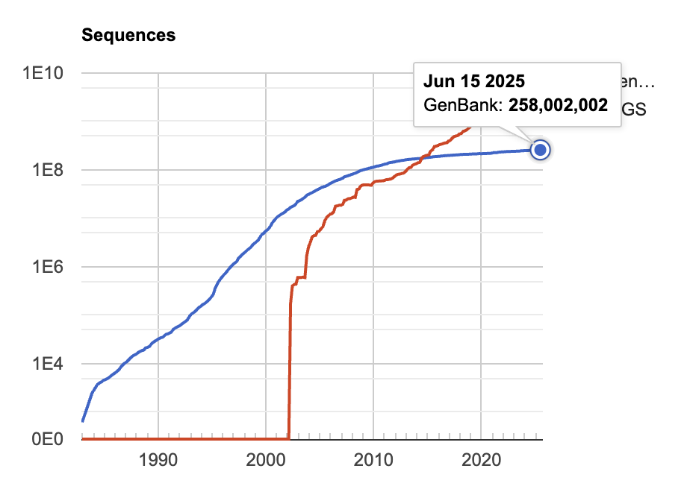
Biological Data Explosion
How did we get here?
https://www.ncbi.nlm.nih.gov/genbank/statistics/

Slide 7
Brief History of Bioinformatics
Haemophilus influenzae WGS
Publication of Human Genome Project by NIH
HGP and CELERA increased sequencing efforts
Rise of Internet & Online resources EMBL (1993), NCBI (1994)
Structural bioinformatics
3rd generation sequencing
Adoption of machine learning, deep learning and structural methods e.g., AlphaFold, ESMFold
Integration of transformer architecture (deep learning) and LLMs
Integrated omics and AI multimodal integration system level modelling of biological processes
DNA double helix solved
Genetic code deciphered
Advances in DNA sequencing e.g. SANGER
Use of DNA sequences for phylogenetic analysis
Term “Bioinformatics” coined
Advances in biology and computer science
The origins
Genomics, Big data
1950-1970
1970-1980
1980-1990
1990-2000
2000-2010
2010-todate
Paradigm Shift to DNA
Dawn of Genomics
ML and AI integration
Foundational discoveries
COMPROTEIN – first bioinformatics computer software -Dayhoff
Dayhoff first bioinformatician
Sequence alignment models – Needleman-Wunch
Amino acid substitution matrix (PAMs) - Dayhoff
Protein based phylogenies
Improved access to computers & specialized software
Gene cloning and Polymerase chain reaction (PCR)
Free software movement influence bioinformatics software development –EMBOSS
Data standardization and sharing between GenBank, EMBL and DDBJ
Bioinformatics journal established
Second (Next) generation sequencing
Lower cost of whole genome sequencing
high-performance computing bioinformatics platforms
Cloud computing – Amazon & Microsoft bioinformatics as service

Slide 8
Where is the data coming from?
RNA
Protein
Phenotype
Selection
Evolution
DNA
Individual
Flow of biological information at an individual level from DNA to phenotype
Biological Information
Evolutionary forces act on phenotypes to shape the genetic makeup of populations
Population

Slide 9
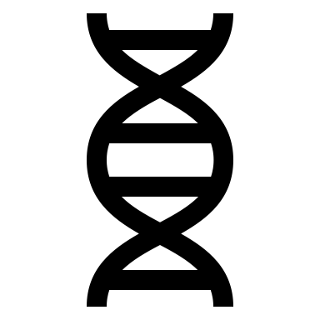
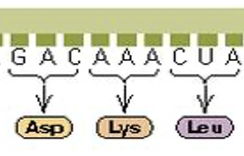
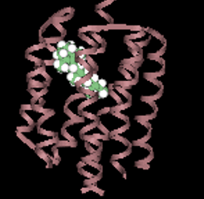
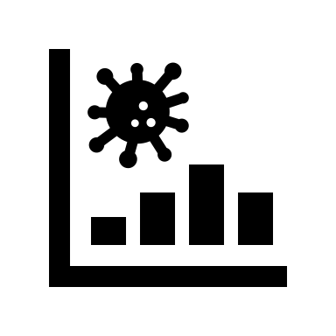
Central paradigm of Molecular biology
DNA
mRNA
Protein
Phenotype
The central paradigm of molecular biology describes the flow of genetic information within a biological system.

Slide 10
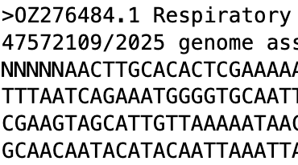
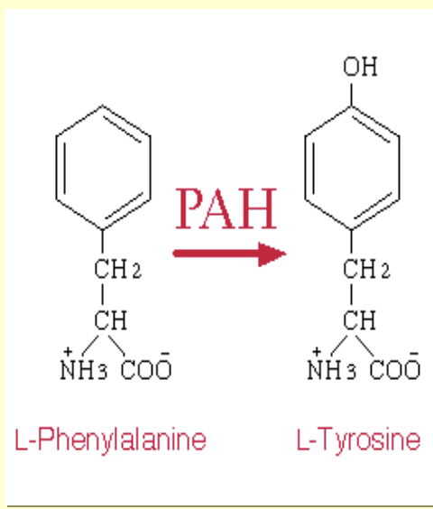
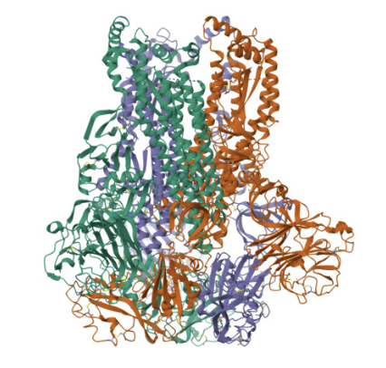
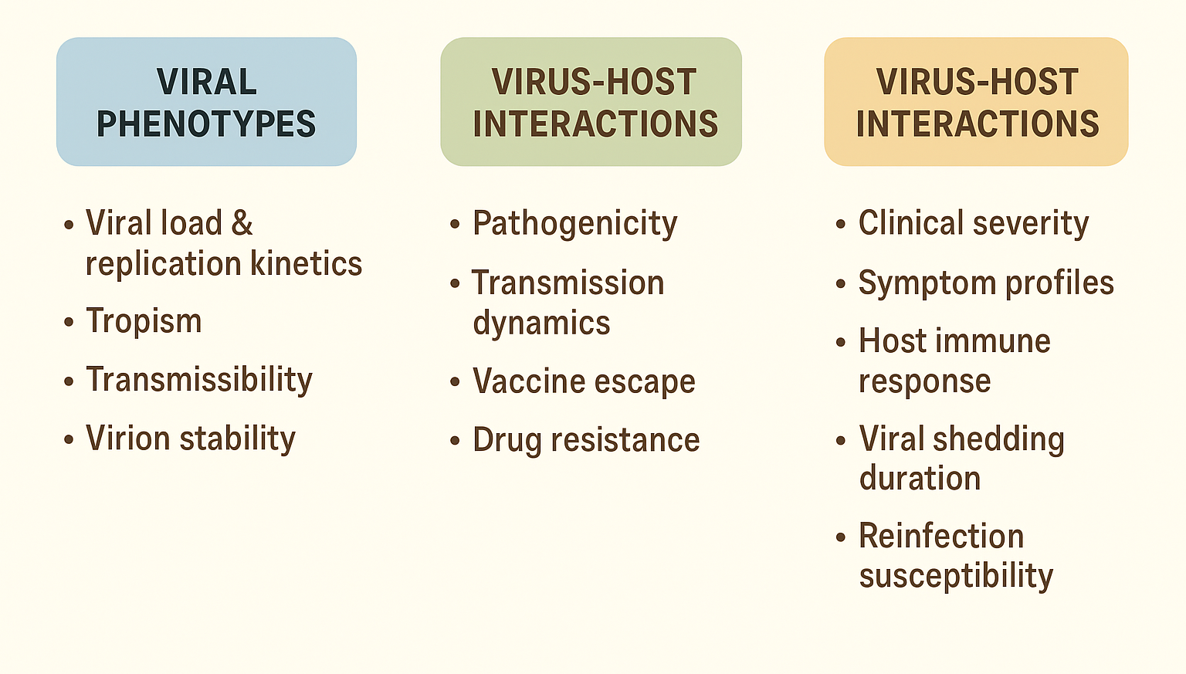
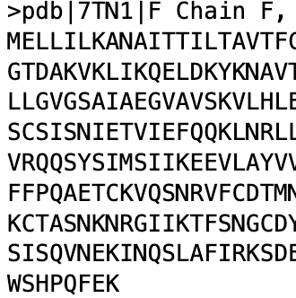
Central Paradigm of Bioinformatics
Genetic information
Molecular Structure
Biochemical function
Phenotype

Slide 11
Central Paradigm of Bioinformatics
Level | Molecular Biology | Bioinformatics Role
DNA | Genetic material, genome sequences | Genome assembly, annotation, variant calling, phylogenomics
RNA | Transcription, gene expression | Transcriptomics (RNA-Seq), splicing analysis, expression quantification
Protein | Translation, structure, and function | Proteomics, structural bioinformatics, protein-protein interaction networks
Phenotype | Observable traits and biological outcomes | Systems biology, pathway analysis, genotype-phenotype association, machine learning models

Slide 12





Sequencing Technologies
A) Sequencing
DNA/RNA sequencing technologies
Next-generation sequencing (NGS) – Illumina, IonTorrent, MGI
Single molecule sequencing
Single-molecule sequencing
PacBio
Oxford Nanopore

Slide 13
Sequencing Technologies
Feature | Long-Read Sequencing | Short-Read Sequencing
Read length | Thousands–millions of bases → covers entire genes/regions | 100–300 bases → high accuracy per base
Genome Assembly | Near-complete, contiguous assemblies → fewer gaps | Fragmented assemblies → lower cost, faster runs
Structural Variants | Detects large variants & repeats → better for complex genomes | Limited detection → better for small variants
Transcript Resolution | Full-length transcripts → accurate isoform analysis | Partial transcripts → good for expression counts
Haplotype Phasing | Direct haplotype resolution → better genetic insights | Requires inference → simpler data analysis
🙋🏾 Which sequencing technology fits your genomic surveillance needs and why?

Slide 14
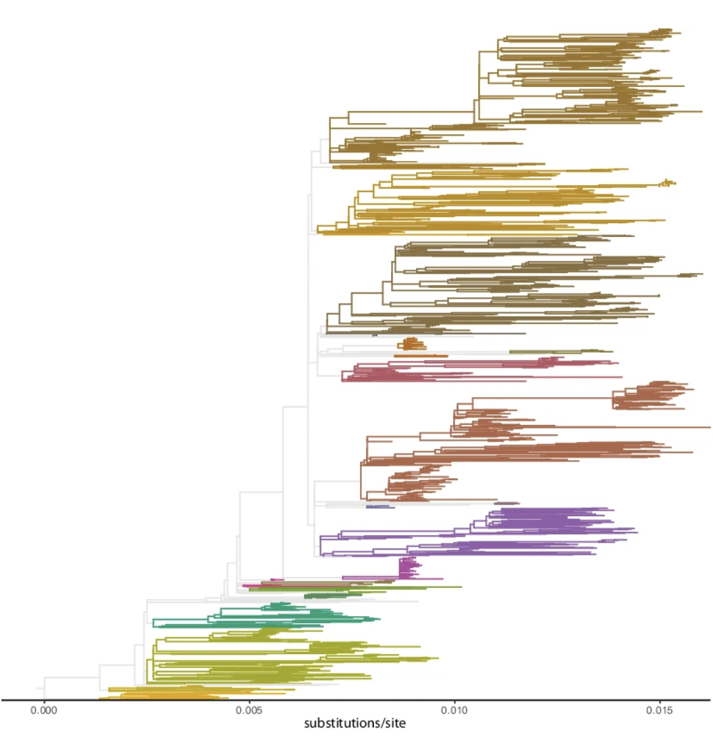
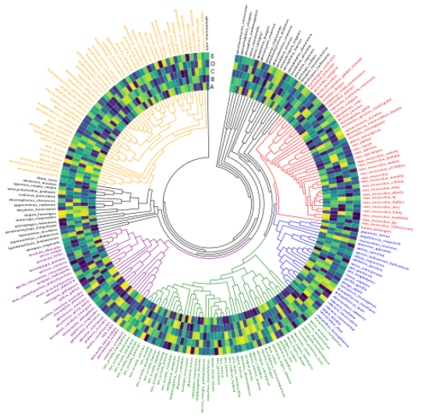
Core Bioinformatics Approaches
A) Genomics
Comparative genomics – genome relatedness
Transcriptomics - Gene expression profiles
Structural genomics - Molecular modelling
B) Metabolomics
Small molecule analysis

Slide 15
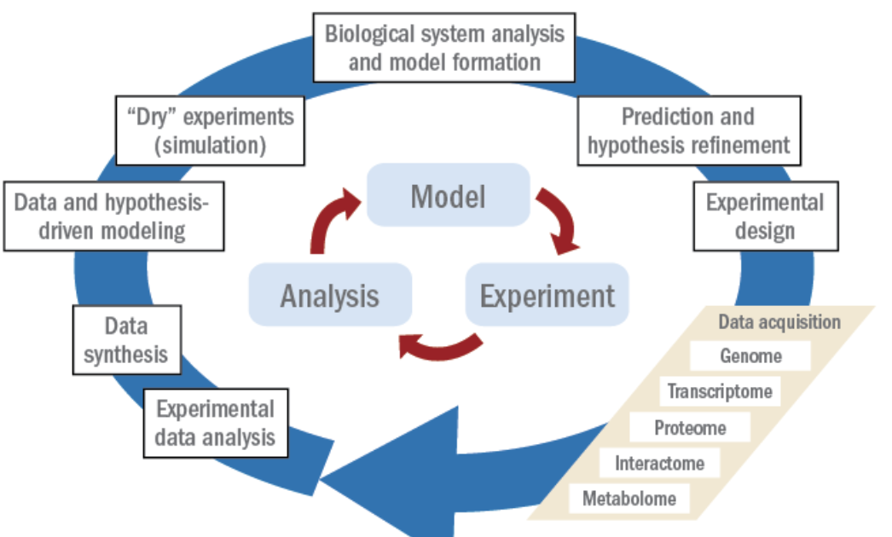
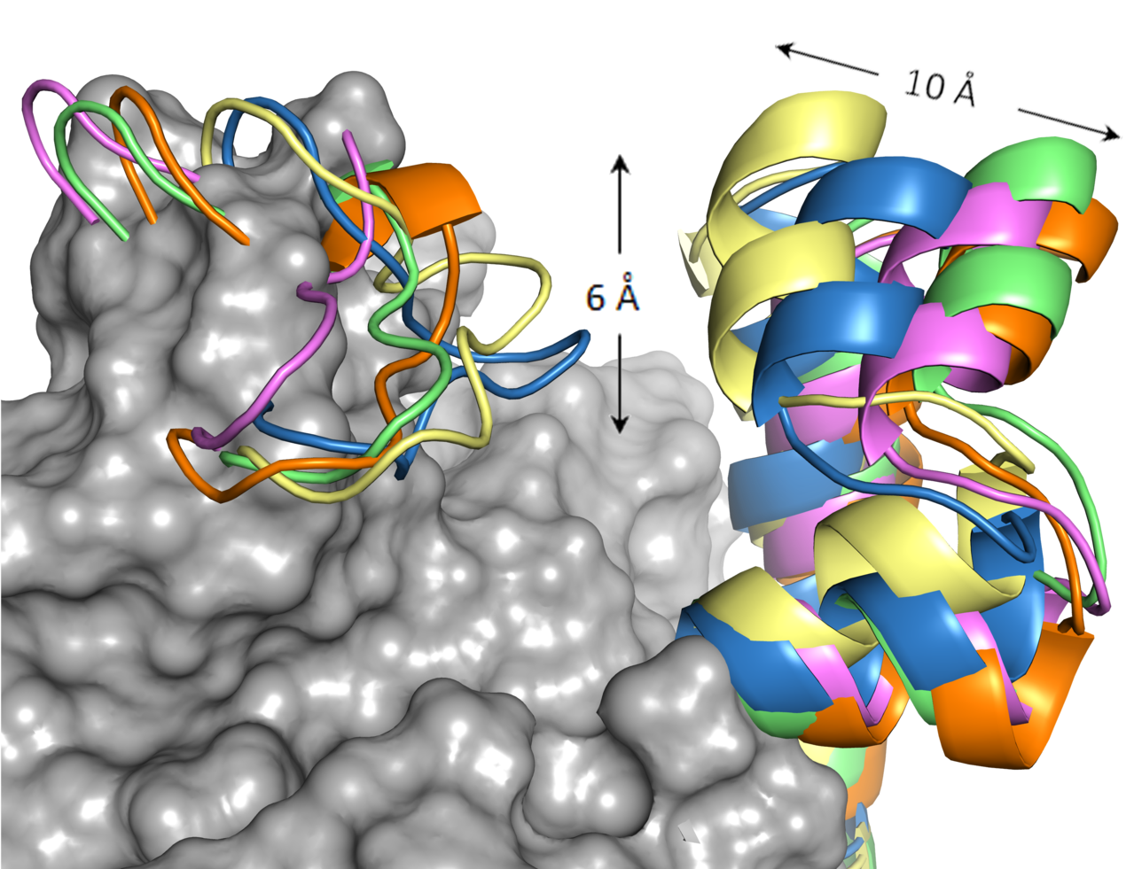
Core Bioinformatics Approaches
C) Proteomics
Large scale study of proteins particularly their structures and function
D) Systems Biology
Study of interactions between the components of biological systems

Slide 16
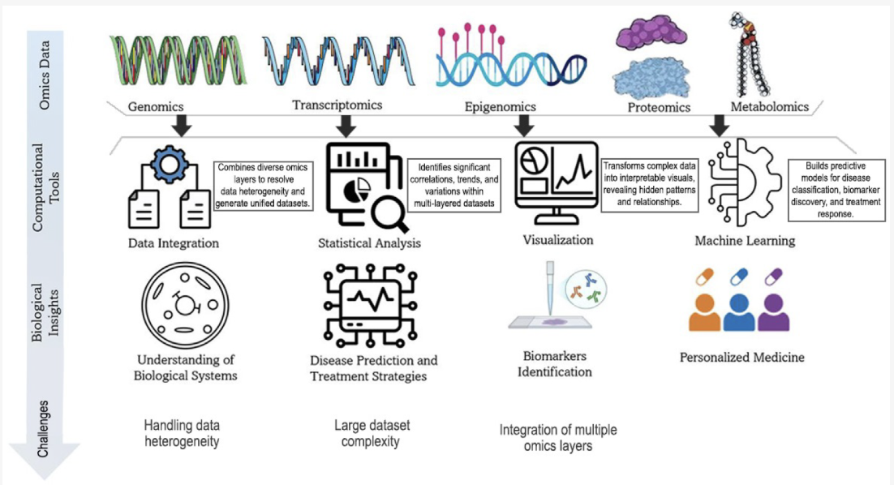
Core Bioinformatics Approaches
E) High throughput data integration
Transcriptomics - Multi-omics integration strategies - integrate multiple “omics’ for a systems understanding not possible from a single-omics strategy
https://www.mdpi.com/2076-3417/15/1/329

Slide 17

Goals of Bioinformatics
Bioinformatics can be used in various ways - the goals include;
data acquisition,
Focus on collecting and storing biological data
tool and database development,
Creating computational resources and databases
data analysis
Extracting insights through computational methods
data integration
Combining diverse datasets for comprehensive understanding

Slide 18
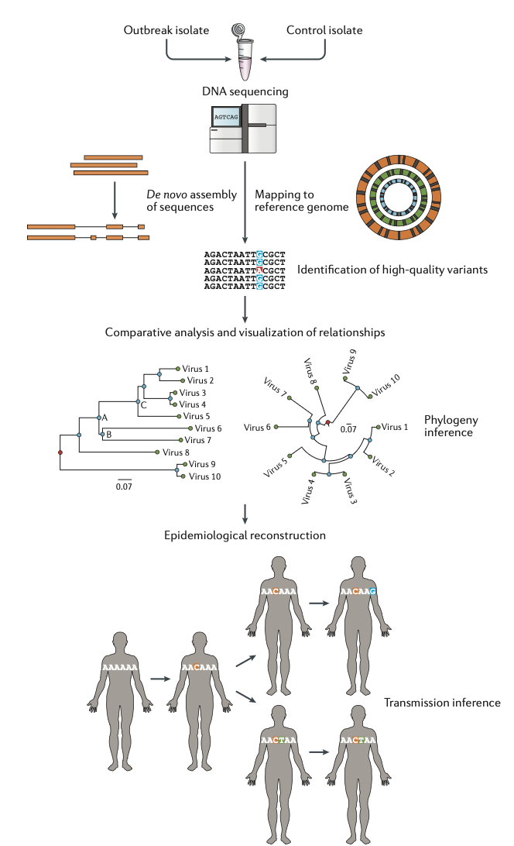
Bioinformatics Applications in Public Health
Genomic surveillance
Identify circulating variants through routine surveillance
Precise outbreak source identification
Inform targeted intervention strategies
Identification of transmission clusters reducing transmission chains

Slide 19

Bioinformatics Applications in Public Health
Vaccine development
Epitope prediction and vaccine candidate identification
Monitoring vaccine escape mutations
Example: Assist in Influenza vaccine strain selection process

Slide 20
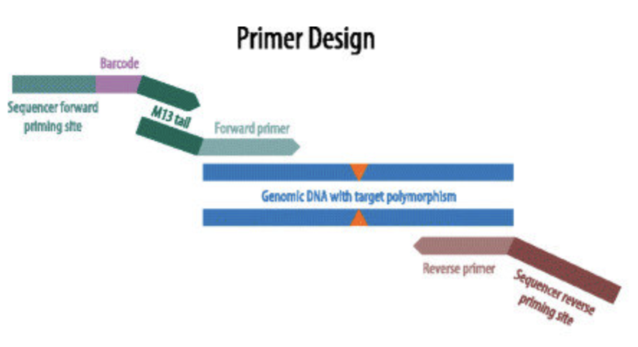
Bioinformatics Applications in Public Health
Molecular diagnostic development
PCR primer and probe design
Multiplex respiratory pathogen panels
Point-of-care genomic testing for rapid identification, accurate detection and reduced diagnostic time

Slide 21

Bioinformatics Applications in Public Health
Antimicrobial Resistance (AMR) detection
Prediction of resistance genes
Genomic characterization of resistance patterns
Inform public health policy and stewardship programs

Slide 22
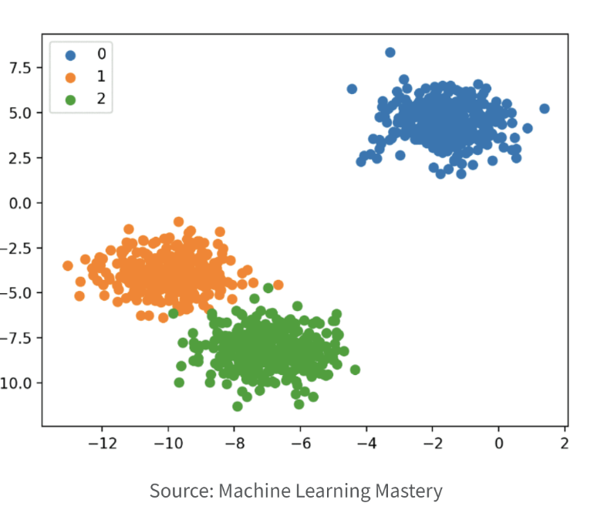
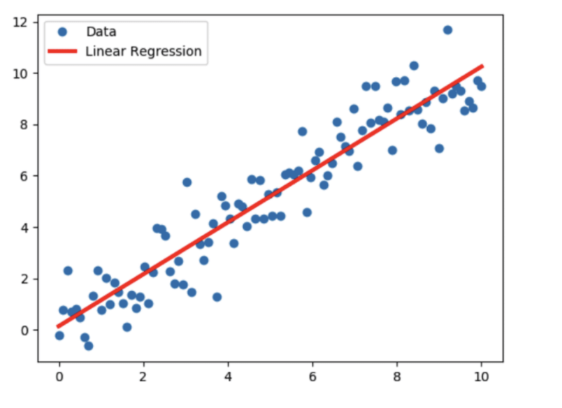
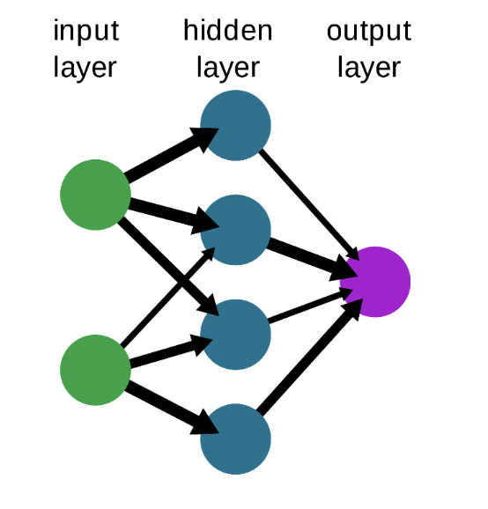
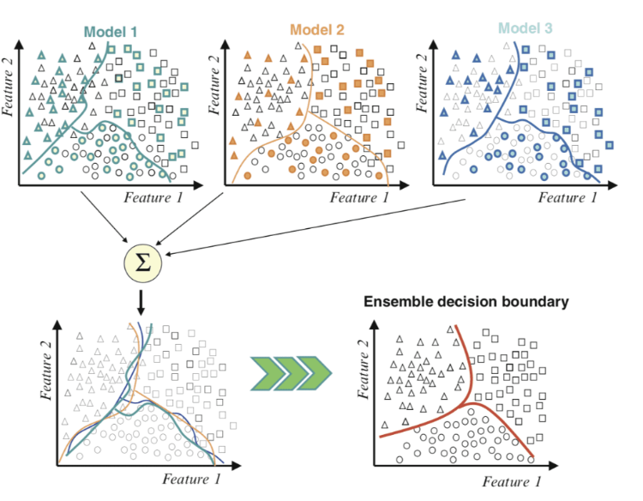
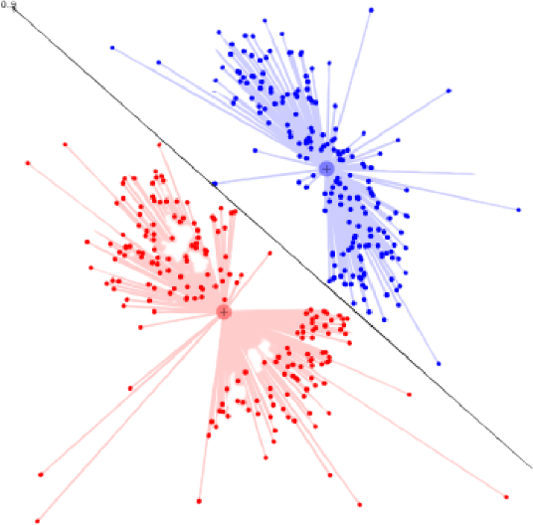
Bioinformatics Applications in Public Health
Integrated predictive modelling
Machine learning for outbreak prediction
Understanding biological processes
Mutation impact assessment – clinical/epidemiological
Accelerated drug discovery and development
Improved disease prediction – discovering novel biomarkers

Slide 23
Bioinformatics Resources
Resource Type | Description | Examples
Databases | Repositories storing biological sequences, structures, or omics data | GenBank, Ensembl, UniProt, PDB, GEO, GISAID
Sequence Analysis | Tools for sequence alignment, annotation, and homology search | BLAST, Clustal Omega, MAFFT, MUSCLE
Phylogenetic analysis | Tools for phylogenetic analysis and visualization | RAxML, IQ-TREE, BEAST, FigTree, MEGA
Molecular Modelling | Software for molecular dynamics and structural simulations | PyMOL, Chimera, GROMACS, AutoDock
Machine Learning Platforms | Tools enabling AI/ML for omics data analysis and modeling. | TensorFlow, scikit-learn, DeepChem
Workflow Management | Pipelines for reproducible bioinformatics workflows | Snakemake, Nextflow, Galaxy
Cloud resources | Bioinformatics analysis platforms | Nextstrain, Nextclade, GISAID, CZID
Version control | Tools for pipeline, software version control, storage | GitHub, GitLab, Bitbucket

Slide 24
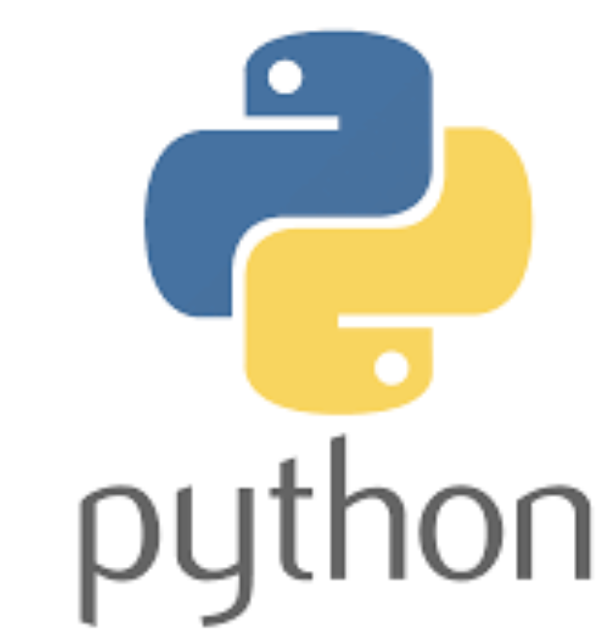

Getting Started in Bioinformatics
Essential Skills Development
Programming: Python, R, command-line proficiency
Statistics: Understanding of experimental design and hypothesis testing
Biology: Solid foundation in molecular biology and genetics
Data management: Version control, reproducible workflows – GitHub,
Learning Resources
Online courses: Coursera, Github, BioStar, Udemy, YouTube
Textbooks: "Bioinformatics and Functional Genomics" by Pevsner
Hands-on tutorials: Galaxy Project, Software Carpentry

Slide 25
Challenges and future direction
Technical challenges
Data standardization and interoperability
Computational scalability for population-scale studies
Integration of multi-modal data types
Infrastructure and human resource capacity
What challenges or barriers are you facing in adopting and implementing bioinformatics or computational methods in your work?

Slide 26
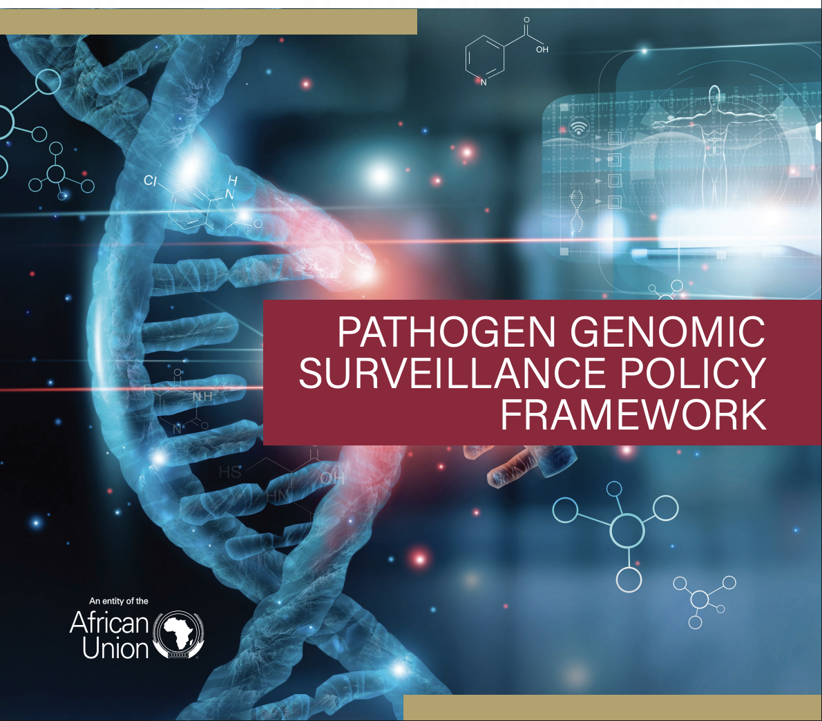
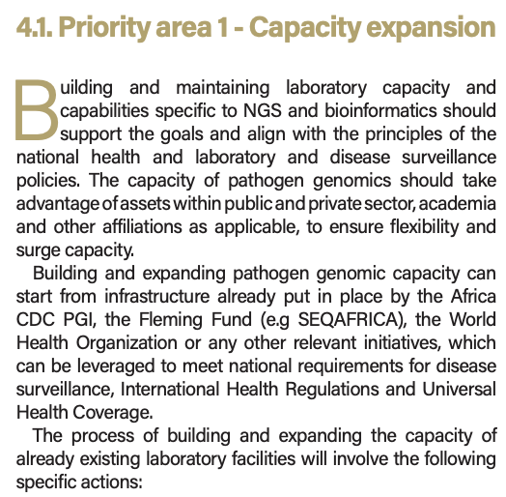

Regional and Global Strategies

Slide 27
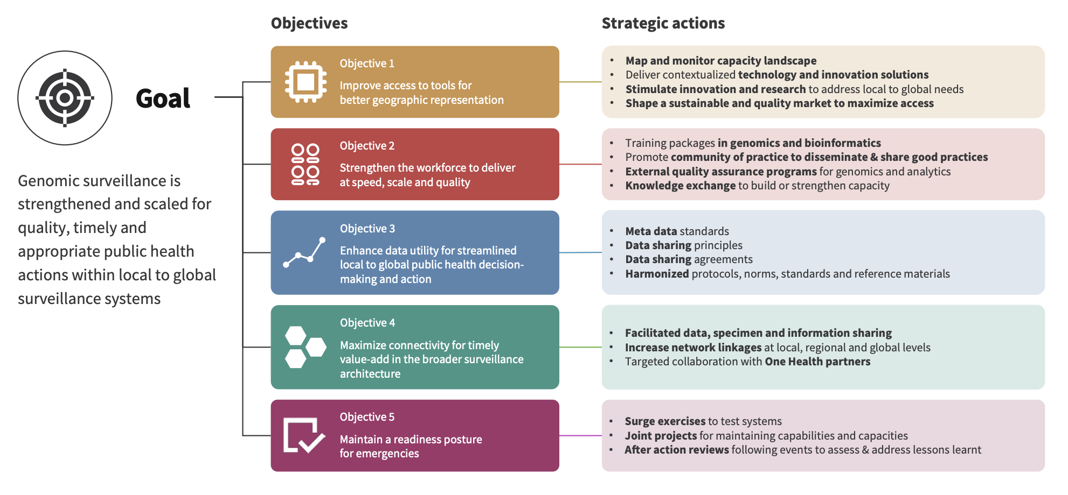
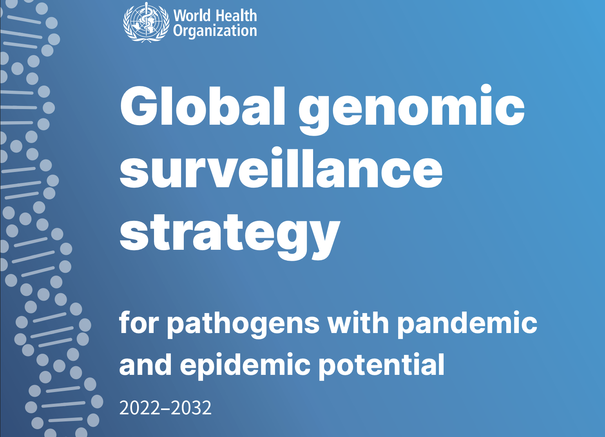
Regional and Global Strategies

Slide 28
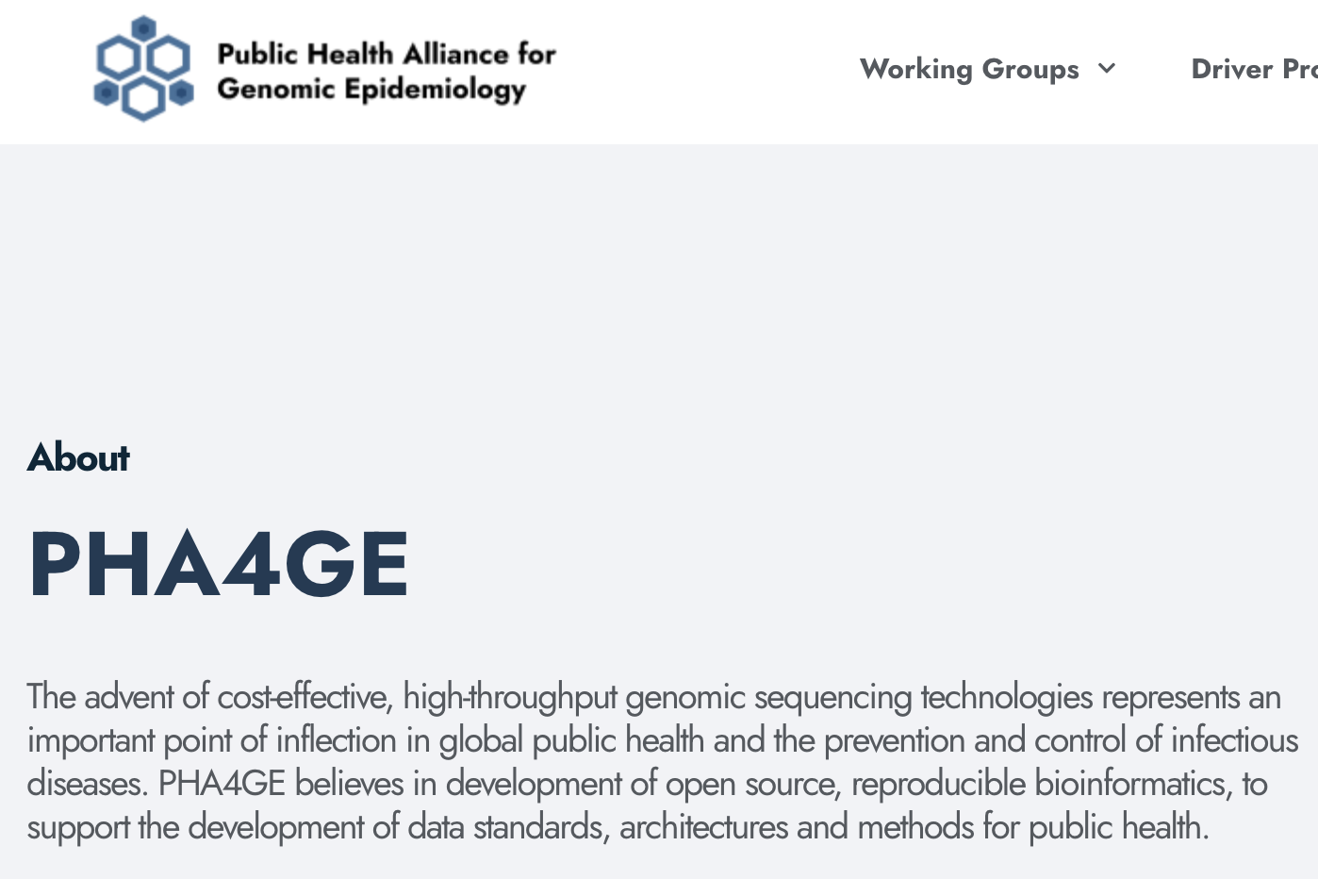
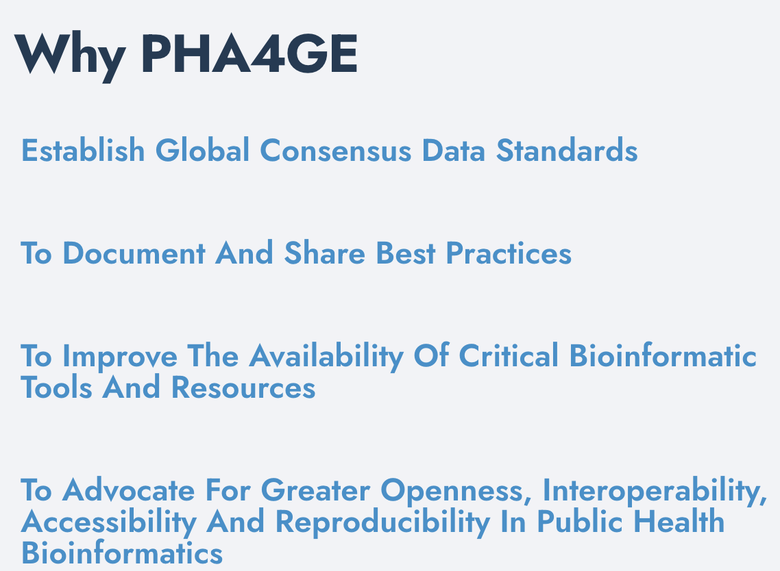
Bioinformatics Community of Practice

Slide 29
Key takeaways
Bioinformatics is essential for modern infectious disease research and public health
Computational approaches are driving rapid advances in pathogen understanding
Exponential growth of publicly available genomic information necessitates the need for increased bioinformatics capacity

Slide 30
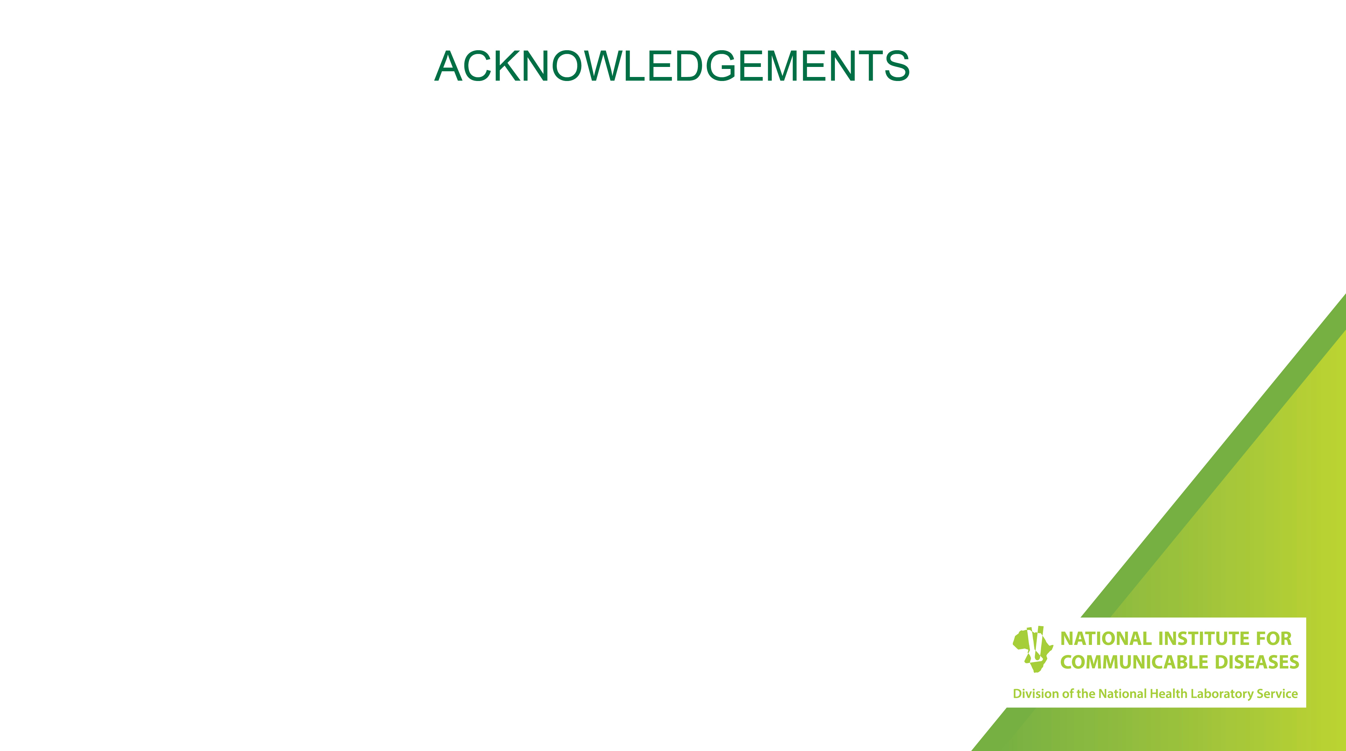
Thank you!

